Slide 1



CHCDIS012
Support community participation and social inclusion (Release 1)

Slide 2

About this Unit of Competency
CHCDIS012 - Support community participation and social inclusion (Release 1)
This unit describes the performance outcomes, skills and knowledge required to assist with supporting people with disability in community participation and social inclusion using a person-centred approach.

Slide 3


This involves enabling people to make choices to maximise their participation in various community settings, functions and activities to enhance psychosocial wellbeing and lifestyle in accordance with the person’s needs and preferences.
This unit applies to workers in varied disability services contexts.
Work performed requires some discretion and judgement and may be carried out under regular direct, indirect or remote supervision.
The skills in this unit must be applied in accordance with Commonwealth and State/Territory legislation, Australian standards and industry codes of practice.

Slide 4

Presentation Objectives
At the end of this session, you will be able to:
Identify opportunities for community participation and social inclusion
Implement strategies for community participation and inclusion
Identify, address and monitor barriers to community participation and social inclusion

Slide 5
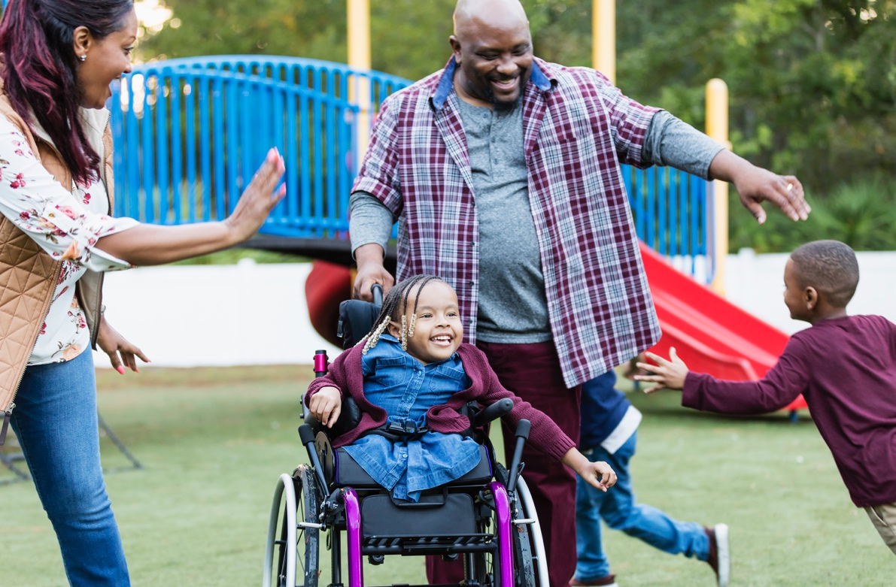
Introduction
A disability is a condition that limits a person's capabilities.
It may affect a person's mobility, ability to learn things, or appropriate communication with others.
Different disabilities can affect people in varying ways.

Slide 6
Under the Disability Discrimination Act 1992 (Cth), disabilities include the following:
Total or partial loss of the person's bodily or mental functions
Total or partial loss of body part
The presence of organisms causing disease or illness in the body
The presence of organisms capable of causing disease or illness in the body
The malfunction, malformation or disfigurement of a part of the person's body

Slide 7
Under the Disability Discrimination Act 1992 (Cth), disabilities include the following:
A disorder or malfunction that results in the person learning differently from a non-disabled person
A disorder, illness or disease that affects a person's:
Thought processes
Perception of reality
Emotions
Judgement
Behaviour

Slide 8

Disabilities also include those conditions that:
Presently exist
Previously existed but no longer exist
May exist in the future
Are attributed to a person

Slide 9

Persons with disability require help from different professionals.
These include professionals such as specialists, doctors and support workers.
To assist persons with disability, you support their community participation and social inclusion.

Slide 10
Inclusion means everyone can take part in society regardless of their race, sex, religion or ability.
Inclusion happens when everyone has equal access to the resources they need to live a full life.
Inclusion for persons with disability means that they can still work, study or do activities equally with persons without disability .
Proper accommodation and support can make this possible.

Slide 11
Social inclusion is inclusion within the community.
An inclusive society welcomes and respects people of all abilities.
This society allows all people to participate in their community.
There is social inclusion when facilities, activities and attitudes allow everyone to participate in their community.

Slide 12
Social inclusion includes the following:
Employment
Public transportation
Education
Social clubs and groups
Recreational and cultural activities

Slide 13
As a disability support worker, part of your job is to support the community participation and social inclusion of your clients.
Supporting means providing help to make something happen or making something more accessible.
This means finding ways for your clients to actively participate in their communities regardless of their disability.

Slide 14
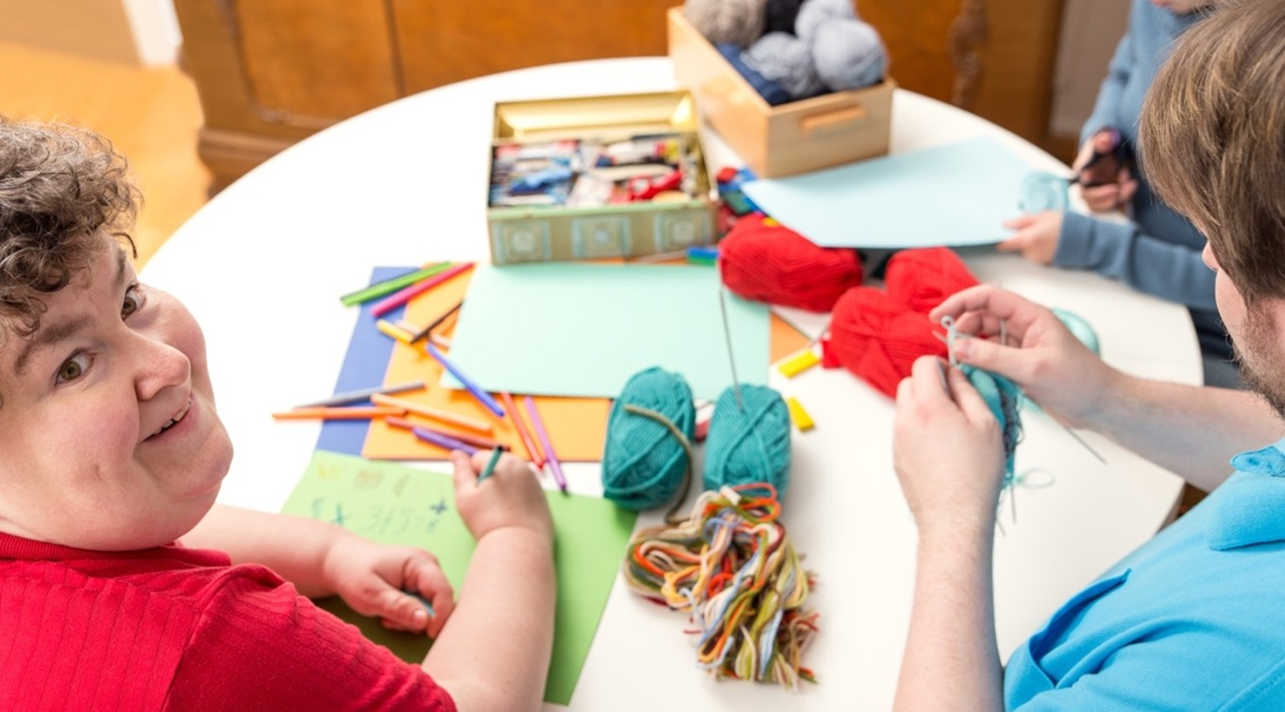
Identify Opportunities for Community Participation and Social Inclusion
CHCDIS012 - Support community participation and social inclusion (Release 1)

Slide 15
An inclusive community allows each member to participate in activities and programs that affect their daily lives.
To support your clients' community participation and social inclusion, you need to know what opportunities are available and to talk to them to understand what they enjoy or want to achieve or try.
You might also recommend places or activities for them that cannot meet their needs or preferences.
Identify Opportunities for Community Participation and Social Inclusion

Slide 16
In this presentation, you will learn how to:
Consult with the person with disability to determine support requirements for engaging with a social network
Identify and access appropriate community participation options that fit the needs and preferences of persons with disability
Identify Opportunities for Community Participation and Social Inclusion

Slide 17

In this presentation, you will learn how to:
Inform persons with disability on community participation options, networks and services
Recognise and accommodate the cultural and religious needs of the person with disability .
Identify Opportunities for Community Participation and Social Inclusion

Slide 18

1.1
Consult With the Person With Disability to Determine Support Requirements for Engaging With a Social Network

Slide 19

Social network is a network of social interaction and personal relationships.
It may be a group of people with similar interests, beliefs or cultures.
Identify Opportunities for Community Participation and Social Inclusion

Slide 20
Social networks include, but are not limited to the following:
Family groups
Disability support groups
Direct neighbourhood or local community
Work groups
Sport and other recreation groups
Age-related groups (youth or senior citizens)
Community centres
Clubs
Identify Opportunities for Community Participation and Social Inclusion

Slide 21
Engaging with a social network can increase a person’s feelings of belonging and purpose.
Aside from that, engaging with a social network can:
Improve the behaviour and attitude of persons with disability , their families and carers
Boost the self-confidence of persons with disability
Provide economic opportunities for persons with disability , such as participation in the workforce
Break negative stereotypes people may have about persons with disability
Identify Opportunities for Community Participation and Social Inclusion

Slide 22

Given these benefits, it is vital that you support your clients in engaging with their chosen social networks.
The support you provide must cater to the various support requirements of your clients.
Identify Opportunities for Community Participation and Social Inclusion

Slide 23
Support requirements include the following:
Interests
Needs
Abilities
Preferences
These refer to what is necessary to live an independent and fulfilling life.
These refer to what the client chooses when presented with various options.
These refer to what ideas and activities the client wants to learn and participate in.
These refer to the means or skills the client has to perform a certain task or activity.
Identify Opportunities for Community Participation and Social Inclusion

Slide 24
You must also determine the requirements your clients may have for their preferred manner of participation.
Manner of participation refers to how persons with disability will interact with others within their social networks and communities.
There are certain stages they go through before they develop a sense of belongingness.
Identify Opportunities for Community Participation and Social Inclusion

Slide 25
The graphic below illustrates the stages persons with disability go through to develop their sense of belongingness:
Appearance
Connection
Contribution
Identify Opportunities for Community Participation and Social Inclusion

Slide 26
As a support worker, you may need to cater to clients' requirements or special requests to ensure their full participation in their social networks and communities.
These requirements may include, but are not limited to:
The amount of time the client can commit
The place where the participation will take place in
The limitation in terms of the number of people involved
The limitation in terms of who are the people involved
Identify Opportunities for Community Participation and Social Inclusion

Slide 27
As you consult with your clients to determine these support requirements, ensure that you:
Understand the client, their impairments and their needs
Determine the strengths and abilities of the client
Help set the goals of the client based on their interests
Confirm the client's preferences for interacting with others
Identify Opportunities for Community Participation and Social Inclusion

Slide 28
1.1.1 Understand the Client, Their Impairments and Their Needs
As a support worker, it is your responsibility to understand your clients.
To understand persons with disability is to recognise that they are unique individuals.
Each person with disability has their own experience of how they interact with others and the world.
Understanding this will help you in determining their needs.
Identify Opportunities for Community Participation and Social Inclusion

Slide 29
To understand your clients and their impairments, you must understand the following:
Social model of disability
Rights and responsibilities of persons with disability
Handicap and discrimination
Active citizenship and what it means to persons with disability
Identify Opportunities for Community Participation and Social Inclusion

Slide 30
Doing so will allow you to understand your clients better.
This makes it easier for clients to state what they need and prefer when engaging with a social network and taking part in their communities.
It also allows you to show your clients that you are fully committed to assisting them.
This assistance is according to how they want to be cared for and not by their impairments.
Identify Opportunities for Community Participation and Social Inclusion

Slide 31
Social Model of Disability
Think of the social model of disability as the lens persons with disability use to view the world.
The model states that impairments are not the leading cause of disability.
It is the barriers set by society that limits people.
We can define impairment as a medical condition that leads to disability.
Impairment is defined as losing control over the body's physical, cognitive or anatomical functions.
Identify Opportunities for Community Participation and Social Inclusion

Slide 32
Impairment can range between three levels:
Mild
Moderate
Impairments cause minor discomfort and changes in physical, social or occupational function.
Impairments cause a notable amount of discomfort. There are also significant changes in physical, social or occupational function.
People under this level need help in doing basic tasks and activities.
Identify Opportunities for Community Participation and Social Inclusion

Slide 33
Impairment can range between three levels:
Severe
Impairments cause an extreme amount of discomfort. There are also serious changes in physical, social or occupational function.
People under this level often cannot complete tasks without help.
Identify Opportunities for Community Participation and Social Inclusion

Slide 34
Disability refers to the relationship between people with impairments and barriers set by society.
These barriers can be considered as factors that affect persons with disability .
As a support worker, you must understand what hinders your clients from living their lives.
Remember that your clients are not disabled because of their impairments.
The barriers set by society are the causes of their disability.
These barriers are what stop them from actively participating in their community.
Identify Opportunities for Community Participation and Social Inclusion

Slide 35
Handicap and Discrimination
When a person with an impairment interacts with society, they often experience discrimination.
Discrimination is the unfair treatment of people on various grounds.
In this case, the person is discriminated against due to their disability.
The Disability Discrimination Act 1992 defines discrimination against persons with disability .
Identify Opportunities for Community Participation and Social Inclusion

Slide 36

Discrimination comes in two forms:
Direct discrimination occurs when a person is treated worse than another person.
Indirect discrimination occurs when a policy or requirement disadvantages a person receiving support.
Identify Opportunities for Community Participation and Social Inclusion

Slide 37
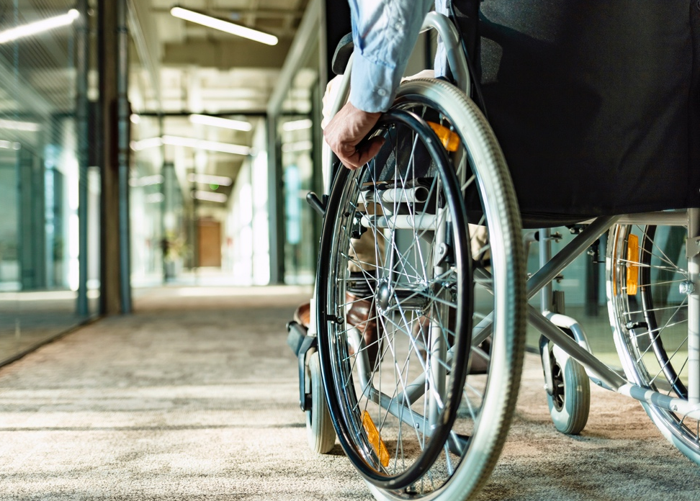
Persons with disability can often recall experiences involving discrimination which include the following:
Being denied service or entry to an establishment due to their condition
Not being considered for job posts and openings due to their condition
Identify Opportunities for Community Participation and Social Inclusion

Slide 38
Persons with disability can often recall experiences involving discrimination which include the following:
Receiving substandard or inappropriate service at:
Hospitals
Schools
Restaurants
Hotels
Other business establishments
Identify Opportunities for Community Participation and Social Inclusion

Slide 39
Persons with disability can often recall experiences involving discrimination which include the following:
Not having access to aids, equipment and assistive technologies for daily activities
Having to endure hurtful remarks and inappropriate language
Being physically excluded from others, such as with:
Separate entrances
Sections in a public establishment
Identify Opportunities for Community Participation and Social Inclusion

Slide 40
When a person experiences a handicap, their impairment does not change.
However, the experience changes their self-image, confidence, relationships and overall capability.
For example, consider an older person lost control of their legs.
This impairment causes a disability in the form of not being able to walk and move around.
The disability can easily be fixed by using a wheelchair.
Identify Opportunities for Community Participation and Social Inclusion

Slide 41
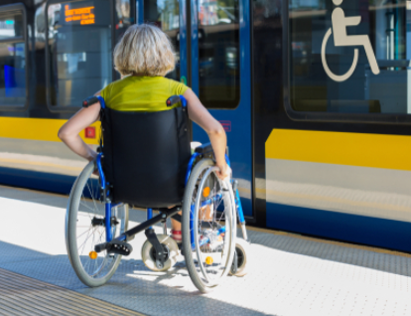
However, when they use a wheelchair to travel around, they may encounter barriers such as:
Not having access to public transport due to a lack of accommodations for wheelchairs
Not having access to elevated areas due to a lack of ramps and lifts
Identify Opportunities for Community Participation and Social Inclusion

Slide 42
The person’s impairment (the loss of control over their legs) stays the same.
The disability (not being able to walk) was already addressed.
The handicap, on the other hand, creates difficulties for the person.
Identify Opportunities for Community Participation and Social Inclusion

Slide 43

These difficulties can be very difficult to fix and manage.
These difficulties can adversely affect a person’s:
Motivation
Drive
Outlook on life
Identify Opportunities for Community Participation and Social Inclusion

Slide 44
This happens as the person with disability has to accept that they cannot remove these difficulties on their own.
Other conditions that can result from unaddressed handicaps and difficulties include:
Mental health problems, such as depression
Overeating and obesity
Undereating
Fatigue and physical injury
Identify Opportunities for Community Participation and Social Inclusion

Slide 45
As a support worker, you will be responsible for preventing the development of these additional health problems.
You can do this by understanding your clients’ experiences with barriers and discrimination.
This ensures that your clients do not suffer from discrimination and harm.
Identify Opportunities for Community Participation and Social Inclusion

Slide 46

Rights and Responsibilities of Persons With Disability
Human rights are the standards used to recognise and protect the dignity of all humans.
These rights serve as the basis for laws and acts governing people and communities.
Identify Opportunities for Community Participation and Social Inclusion

Slide 47
The Australian Human Rights Commission (2019) states that human rights:
Recognise the inherent value of each person
Are based on principles of dignity, equality and mutual respect
Are about being treated fairly, treating others fairly, and having the ability to make genuine choices in our daily lives
Identify Opportunities for Community Participation and Social Inclusion

Slide 48
The Australian Government agreed to respect and uphold many human rights treaties, including the following:
United Nations Universal Declaration of Human Rights
International Covenant on Civil and Political Rights
International Covenant on Economic, Social and Cultural Rights
Convention on the Elimination of All Forms of Racial Discrimination
Convention on the Elimination of All Forms of Discrimination against Women
Identify Opportunities for Community Participation and Social Inclusion

Slide 49
The Australian Government agreed to respect and uphold many human rights treaties, including the following:
Convention Against Torture and Other Cruel, Inhuman or Degrading Treatment or Punishment
Convention on the Rights of the Child
Convention on the Rights of Persons with Disabilities
Identify Opportunities for Community Participation and Social Inclusion

Slide 50
The rights and responsibilities of persons with disability can be found in the following declarations and treaties:
Universal Declaration of Human Rights (UDHR)
Convention on the Rights of Persons with Disabilities (CRPD)
Identify Opportunities for Community Participation and Social Inclusion

Slide 51
All support workers must know and understand the basic human rights and responsibilities that apply to everyone.
These are outlined in the UDHR.
Additionally, disability support workers who support persons with disability must understand the CRPD.
The Convention contains many basic human rights also found in the UDHR.
The CRPD contains general and specific obligations.
These aim to protect the rights and responsibilities of all persons with disability.
Identify Opportunities for Community Participation and Social Inclusion

Slide 52

The two documents in the CRPD consist of the following:
The actual rights and responsibilities of persons with disability
An optional protocol for upholding these rights and addressing complaints
Identify Opportunities for Community Participation and Social Inclusion

Slide 53
Human rights are vital for a person to understand any specific needs or preferences they may have.
A person who knows their rights has a better understanding of:
What they are entitled and allowed to do
What others are not allowed to do
What the state or country, as a whole, is required to do to accommodate them
Identify Opportunities for Community Participation and Social Inclusion

Slide 54

Therefore, any support worker who truly wishes to support persons with disability must help them learn their rights.
Doing so can help persons with disability better understand how they can control their lives.
It also aids persons with disability in their decision-making.
Identify Opportunities for Community Participation and Social Inclusion

Slide 55
Active Citizenship and What It Means to Persons with Disability
Active citizenship refers to being earnestly involved with one’s local community.
This intersects the rightful place of persons with disability in their communities.
Rightful place in the community refers to the right of persons with disability to participate in their community.
This means there should be support for them to take an active role in their communities.
Identify Opportunities for Community Participation and Social Inclusion

Slide 56
You can find the articles on these rights in two separate declarations and treaties:
Articles 27 and 29 of the basic human rights found in the UDHR
Article 19 of the fundamental rights of persons with disability found in the CRPD
Identify Opportunities for Community Participation and Social Inclusion

Slide 57
1.1.2 Confirm the Client's Preferences for Interacting With Others
As a support worker, it is vital that you discuss with the client how they want to be supported when interacting with others.
This ensures that you provide them with the support they want as they engage with their social networks.
Discussing with clients what kind of support they want also lets you understand their preferred manner of participation.
To do so, you must understand the principles of person-centred practice.
Identify Opportunities for Community Participation and Social Inclusion

Slide 58

As the name suggests, a person-centred practice means involving the person with disability in their service delivery.
This means treating the person with disability first, focusing on what they can do rather than their condition or disability.
Identify Opportunities for Community Participation and Social Inclusion

Slide 59
A person-centred practice:
Supports the person, at the ‘centre of the service,’ to be involved in making decisions about their life
Takes into account each person’s life experience, age, gender, culture, heritage, language, beliefs and identity
Requires flexible services and support to suit the person’s wishes and priorities
Identify Opportunities for Community Participation and Social Inclusion

Slide 60
A person-centred practice:
Is strengths-based, where people are acknowledged as the experts in their life with a focus on what they can do first, and any help they need second
Includes the person’s support network as partners
Identify Opportunities for Community Participation and Social Inclusion

Slide 61
The following table shows how person-centred practice differs from traditional services:
Traditional | Person-centred
Service is based on clinical or medical advice Persons with disability are required to comply with the support staff’s instructions | Service is based on the personal goals and preferences of the person with disability Persons with disability are empowered to make their own choices and decisions
Identify Opportunities for Community Participation and Social Inclusion

Slide 62
The following table shows how person-centred practice differs from traditional services:
Traditional | Person-centred
Care strategies prioritise the management of illness and medical condition | Care strategies focus on improving the overall quality of life of the person with disability
Identify Opportunities for Community Participation and Social Inclusion

Slide 63
By following the principles of person-centred practise, you will ensure that your clients’ opinions are heard and they will have the following benefits:
Your clients will generally have an easier time developing and maintaining trust in you
Your clients will be more engaged with activities and programs designed based on their needs and preferences
You will not have a difficult time coming up with support strategies for your clients
You will not need to spend a lot of time and effort encouraging your clients to participate in certain activities
Identify Opportunities for Community Participation and Social Inclusion

Slide 64
Discussing and Confirming With Your Clients Their Preferences
When discussing with your clients their preferences for engaging with a social network, you must do the following:
Ensure the rights of the client are upheld.
Ensure that the needs of the client are upheld.
Identify Opportunities for Community Participation and Social Inclusion

Slide 65
Here are some strategies you may use to confirm their preferences for engaging with a social network and the manner of participation:
Ask the client to repeat what they said.
Repeat and restate what the client said.
Thank the client and show your understanding.
Follow the principles of active listening.
Identify Opportunities for Community Participation and Social Inclusion

Slide 66
The following are questions you can ask to confirm with your clients their preferences:
Would you mind repeating that for me again?
I don’t think I got what you said. Could you go over that again?
I don’t think I quite understand what you meant. Would you mind repeating that?
If I understand correctly, you are saying… Does that sound right?
My impression of what you said was… Is that what you meant?
Identify Opportunities for Community Participation and Social Inclusion

Slide 67
1.1.3 Help Set the Goals of the Client Based on Their Interests
The level of engagement of persons with disability depends significantly on their interests.
If a person with disability likes what they are doing, they are more likely to stay motivated to engage in an activity or finish a task.
As the support worker, you must identify the goals that will guide you and your clients when engaging with their chosen social networks.
To do so, you may work with the person with disability to set their goals from their interests.
Identify Opportunities for Community Participation and Social Inclusion

Slide 68

Goal setting refers to deciding what the person with disability wants to achieve.
The person with disability can have an easier time participating in their community.
Without goals, it can be difficult for the person with disability to determine what activity they want to do or participate in.
Identify Opportunities for Community Participation and Social Inclusion

Slide 69
When setting goals, you must first consider the long- and short-term goals of the person with disability.
To differentiate, these are defined as follows:
Long-term goals – These refer to the goals the person with disability wants to accomplish in the far future.
Short-term goals – These refer to the goals the person with disability wants to accomplish soon.
Identify Opportunities for Community Participation and Social Inclusion

Slide 70
Short-term goals they may set can include:
Learning how to bake bread rolls
Acquiring the necessary qualifications for baking
Taking up an apprenticeship in a pastry shop or bakery
Identify Opportunities for Community Participation and Social Inclusion

Slide 71
You may use the SMART goals framework as the guiding principle which consists of the following:
Specific – The goals set should be well-defined and clear for more effective planning.
Measurable – The goals set should have the means to track the client’s progress objectively.
Attainable – The goals set should be realistic and within the client’s capacity.
Identify Opportunities for Community Participation and Social Inclusion

Slide 72
You may use the SMART goals framework as the guiding principle which consists of the following:
Relevant – The goals set should be beneficial to the client.
Time-bound – The goals set should have a start and finish date to give a sense of urgency.
Identify Opportunities for Community Participation and Social Inclusion

Slide 73

1.1.4 Determine the Strengths and Abilities of the Client
A common problem for persons with disability is that they may lack self-confidence.
This may have arisen from experiences of difficulties or even discrimination.
As such, a person with disability may hesitate to provide information on their abilities.
Identify Opportunities for Community Participation and Social Inclusion

Slide 74
As a support worker, you can use strengths-based practice to build up their confidence.
The strengths-based practice is a holistic approach that builds upon the strengths of the person with disability.
Knowing their strengths allows them to see themself at their best.
This person-led practice gives an idea of what their current abilities are.
This can help them consider what can be done to improve the quality of their life.
Identify Opportunities for Community Participation and Social Inclusion

Slide 75
You may use the following principles to guide you in determining the strengths and capabilities of persons with disability:
The person with disability has individual aspects that help them grow
The person with disability has a responsibility to maintain and improve their wellbeing
The person with disability has the willingness to learn, improve and change
Identify Opportunities for Community Participation and Social Inclusion

Slide 76
Strengths-based practice is essential when determining the abilities of a person with disability.
The strengths-based practice also aids you in understanding their preferred manner of participation.
When the person with disability feels that their input is necessary, they will be more willing to provide detailed information on how they want to engage with others.
They will also participate more in decision-making and planning.
Identify Opportunities for Community Participation and Social Inclusion

Slide 77
To determine the strengths and abilities of the person with disability, you may ask the following questions:
What are three (or any number) things that are going well in your life right now?
What things should happen for you to have a good time with other people?
What could you do that would make your interactions with others better?
What do you find you learn or do most easily?
How would you describe your strengths and skills?
Identify Opportunities for Community Participation and Social Inclusion

Slide 78

1.2
Identify and Access Community Participation Options That Fit the Needs and Preferences of the Person With Disability

Slide 79
It is imperative that persons with disability have access to options available for them to fully participate in their communities.
Community participation options refer to the following that is available for persons with disability to use to participate in their communities:
Resources
Programs
Aids and equipment
Agencies
Services
Identify Opportunities for Community Participation and Social Inclusion

Slide 80
Community Inclusion and Best Practice Examples
Community inclusion means everyone can access and fully participate in the options available in the community.
Best practices in community inclusion mean that persons with disability have access to a fully accessible community.
Environments, services or products are designed to be easily used by everyone.
The design is made for all community members rather than one group of people.
Identify Opportunities for Community Participation and Social Inclusion

Slide 81
Community inclusion has the following principles:
Participation
A person develops a sense of belonging through interacting with other members of the community.
Encounter
A person may or may not develop relationships through unexpected meetings with other members of the community.
Presence
A person is physically within their community but has little contact with other members of the community.
Identify Opportunities for Community Participation and Social Inclusion

Slide 82
Using best practices in community inclusion means ensuring that resources work in an intentionally accessible and inclusive way to people of all abilities.
It is not enough to develop strategies for inclusivity after a person with disability attempts to use a resource.
Best practice means ensuring that the facilities, activities and attitudes are accessible and inclusive beforehand.
This creates a welcoming and appropriate community for everyone who wants to participate in it.
Identify Opportunities for Community Participation and Social Inclusion

Slide 83
Best practice examples of community inclusion include the following:
A playground designed to be accessible for:
A child who uses mobility aids
A child with reduced mobility
A child with sensory challenges
A workplace that offers:
Reasonable adjustments to employees with cognitive disabilities
Ergonomic equipment for employees with physical and mobility disabilities
Identify Opportunities for Community Participation and Social Inclusion

Slide 84

1.2.1 Community Participation Options
This section will discuss how you can identify the appropriate community participation option for your clients based on their needs and preferences.
Identify Opportunities for Community Participation and Social Inclusion

Slide 85
Resources
Resources refer to sources of information on how persons with disability can participate in their community.
As a disability support worker, your responsibility is to have up-to-date information on how your clients can participate within their communities.
Identify Opportunities for Community Participation and Social Inclusion

Slide 86
Some community participation resources include:
Research articles by government agencies, organisations and individuals who conduct research involving persons with disability
Reports by advocacy groups, national and state authorities and other organisations representing persons with disability
Updates and reports from news organisations, government declarations and other official sources
Identify Opportunities for Community Participation and Social Inclusion

Slide 87
Some community participation resources include:
Articles and blog posts from highly reputed academic or professional websites
Other similar sources that aim to inform persons with disability and their family and carers about options for community participation
Identify Opportunities for Community Participation and Social Inclusion

Slide 88

Programs
Programs are activities and initiatives conducted by different organisations with the goal of supporting persons with disability in community participation.

Slide 89
The community participation of persons with disability may include:
Volunteer programs
Financial support programs
Educational programs
Other similar programs that aim to help persons with disability to better participate in community activities
Identify Opportunities for Community Participation and Social Inclusion

Slide 90
Agencies
Agencies are organisations that provide specific services to persons with disability.
These services provide support to persons with disability in participating in their communities.
Agencies include organisations that provide:
Rights and advocacy services
Legal services
Health services
Other similar services that will help persons with disability in community participation
Identify Opportunities for Community Participation and Social Inclusion

Slide 91

Services
Services are the systems placed to address certain needs persons with disability have in order to live a fulfilling and independent life.
Identify Opportunities for Community Participation and Social Inclusion

Slide 92

The following are relevant services that can aid clients in community participation.
Assistive technology
Dietetics
Occupational therapy
Physiotherapy
Social work
Speech therapy
Identify Opportunities for Community Participation and Social Inclusion

Slide 93
Aside from the services mentioned, clients may also have the need for transport services for their community participation.
Transport services refer to services provided by certain organisations to help persons with disability move around different locations in their community.
Identify Opportunities for Community Participation and Social Inclusion

Slide 94
Services may include the following:
Taxi services
Shuttle services
Rental services
Public transport access assistance
Identify Opportunities for Community Participation and Social Inclusion

Slide 95
Transportation is also essential for persons with disability.
Without transportation that caters to their individual needs, it may be tough for them to reach their destinations.
This is especially true for those who do not own a private vehicle.
To address this need, each state and territory made sure that they have transportation means that are inclusive for persons with disability.
Identify Opportunities for Community Participation and Social Inclusion

Slide 96

1.3
Inform the Person With Disability on Community Participation Options, Networks and Services

Slide 97
Informed decision-making is when a person has all the knowledge they need to make a good decision.
This includes the steps, risks and benefits of any community participation option.
This can also include possible alternative options they can choose instead.
Additionally, the person must know what will happen if they decide to pursue a particular option.
Identify Opportunities for Community Participation and Social Inclusion

Slide 98
As a support worker, you must provide your clients with information on the following in the context of community participation:
Options
Networks
Services
Identify Opportunities for Community Participation and Social Inclusion

Slide 99
1.3.1 Providing Information on Community Participation
Recall the community participation options discussed in the previous subchapter.
These options include the following:
Resources
Programs
Aids and equipment
Agencies
Services
Identify Opportunities for Community Participation and Social Inclusion

Slide 100

Community Participation Networks
Community participation networks refer to networks that allow persons with disability to connect with others in their community.
Identify Opportunities for Community Participation and Social Inclusion

Slide 101
These include the following:
Social Networks – It refers to opportunities for persons with disability to connect with other people in their community based on common interests.
Work Networks – It refers to opportunities for persons with disability to participate in work by connecting with employers and other workers.
Identify Opportunities for Community Participation and Social Inclusion

Slide 102
1.3.2 Community Information About Sporting, Cultural, and Specific-Interest Groups
Part of your job is to give your clients information that is relevant to their interests.
These interests may fall into the following groups:
Sporting Groups
Groups that hold activities oriented towards sports, such as soccer, basketball, swimming, etc.
Cultural Groups
Groups that hold activities oriented towards supporting and connecting people of a certain culture.
Specific-Interest Groups
Groups that hold activities oriented towards catering to certain interests, such as reading, music, etc.
Identify Opportunities for Community Participation and Social Inclusion

Slide 103
Your clients should know about the local agencies and services available to them and how to access these.
Access to these agencies and services allows them to gather community information on the activities that cater to their interests, such as:
Benefits of the activity the client wants to try
Options for where they can do the activity
Important details about the activity providers, such as costs and facilities
Identify Opportunities for Community Participation and Social Inclusion

Slide 104
It is also part of your job to ensure that your clients get the resources they need to participate in interest-based activities.
Resources to participate in the different interest groups include the following:
Technology
Human and animal resources
Financial support resources
Identify Opportunities for Community Participation and Social Inclusion

Slide 105

1.3.3 Strategies for Strengthening Options, Networks and Services for Persons With Disability
As a disability support worker, it is your responsibility to strengthen options, networks and services for your clients.
Identify Opportunities for Community Participation and Social Inclusion

Slide 106
The following are strategies that you may use as you support your clients regarding the community participation options, networks or services:
Have regular consultations with the client regarding the options, networks and services.
Keep track of options, networks and services being provided to the client.
Continuously look for options, networks and services the client may find useful in the future.
Consult with your colleagues or supervisor.
Identify Opportunities for Community Participation and Social Inclusion

Slide 107
With these strategies, you can continuously provide your clients with options, networks and services that fit their needs and interests.
This can ensure that your clients will be happy with the support provided to them for their community participation.
More importantly, strengthening these options can encourage their sense of belongingness.
Identify Opportunities for Community Participation and Social Inclusion

Slide 108

1.4
Recognise and Accommodate the Cultural and Religious Needs of the Person With Disability

Slide 109
Cultural needs refer to a wide variety of needs based on a person's social and ethnic identities.
Culture, in this context, can refer to how a person identifies themself and their group.
As such, cultural needs can be based on ethnic background combined with:
Sexual orientation
Spoken language
Other forms of group identification
Identify Opportunities for Community Participation and Social Inclusion

Slide 110

Religious needs, on the other hand, refer to a variety of needs based on a person’s spiritual beliefs or faith.
Religion refers to how a person observes a particular faith or religion.
Identify Opportunities for Community Participation and Social Inclusion

Slide 111
As such, religious needs can be based on the person’s religion and the particular strand they are a part of, such as the following:
Buddhism
Christianity
Roman Catholicism
Eastern Orthodoxy
Protestantism
Theravada Buddhism
Mahayana Buddhism
Vajrayana Buddhism
Identify Opportunities for Community Participation and Social Inclusion

Slide 112
As such, religious needs can be based on the person’s religion and the particular strand they are a part of, such as the following:
Hinduism
Islam
Sunni
Shia
Vaishnavism
Shaivism
Identify Opportunities for Community Participation and Social Inclusion

Slide 113
Some examples of cultural and religious needs are as follows:
Physical
Food and eating schedule
Preferred clothing
Social
Communication style, language, and choice of words based on cultural background
Preferred visitors and times of visit
Identify Opportunities for Community Participation and Social Inclusion

Slide 114
Some examples of cultural and religious needs are as follows:
Spiritual
Religious symbols and items
Prayers and other religious traditions
Identify Opportunities for Community Participation and Social Inclusion

Slide 115
Providing your clients’ cultural and religious needs is a requirement for providing support.
Also, your clients have the right to require service that does not discriminate based on their cultural and religious backgrounds.
As a support worker, you must recognise and accommodate these needs as you support your clients.
Identify Opportunities for Community Participation and Social Inclusion

Slide 116
Recognising and Accommodating the Cultural Needs of Your Clients
The following steps show how a support worker can recognise and accommodate the cultural and religious needs of their client:
Secure a good understanding of your client’s cultural and religious needs.
Provide your client’s cultural and religious needs.
Adjust service based on your client’s feedback and reactions.
Identify Opportunities for Community Participation and Social Inclusion

Slide 117

What have we learnt?
In this part of the session, we have covered:
Identify opportunities for community participation and social inclusion
Implement strategies for community participation and inclusion
Identify, address and monitor barriers to community participation and social inclusion

Slide 118
End of Chapter 1

